Slide 1


Project Week 3
Music Recommender
GET STARTED

Slide 2
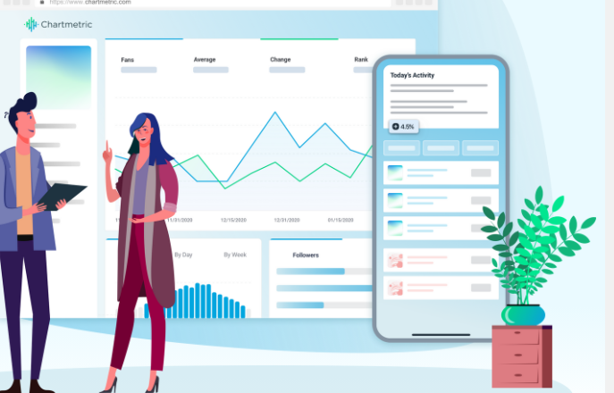
Goal of Analysis
More than two social media data sources plus the power of data science … all in one place.
Increase the options of www.gnoosic.com, by song title
Increase the best fit of suggestions (algorithms)

Slide 3
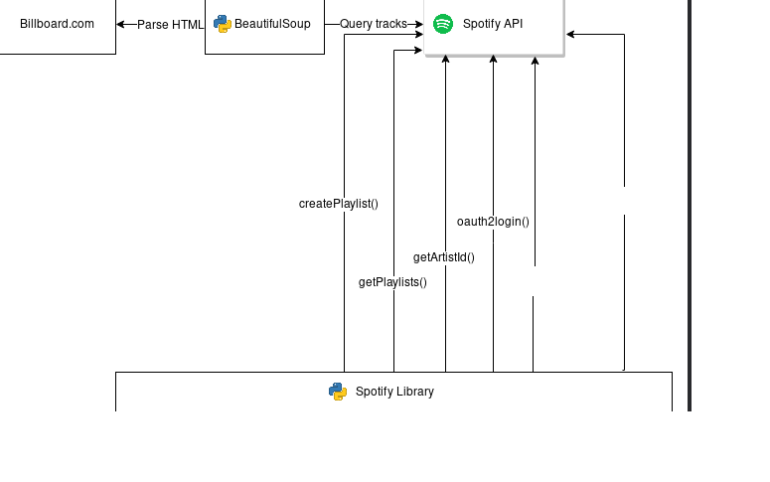
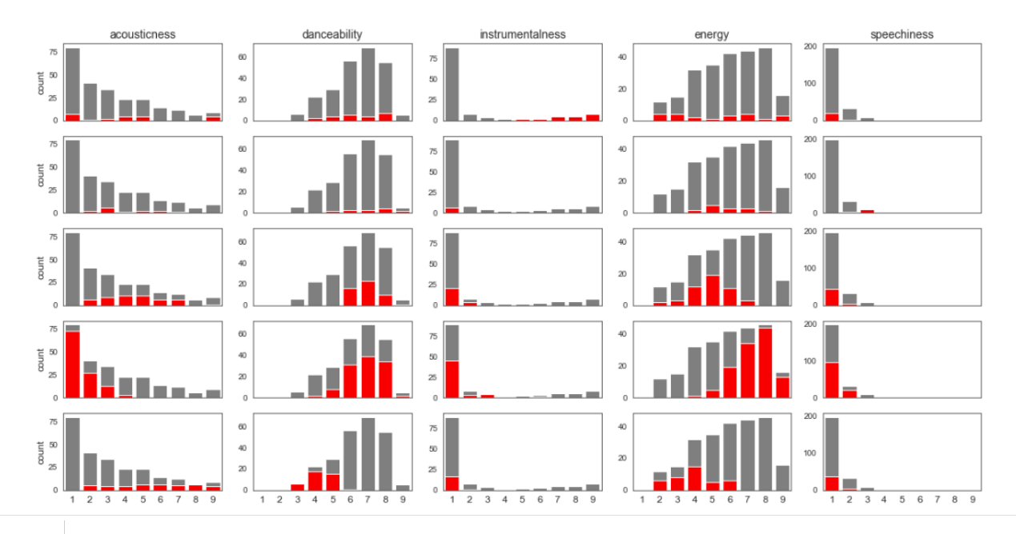
Idea- Extend database

Slide 4
Idea- Match songs by their audio features

Slide 5

Extensions
Increase the number of partnerships
Increase the best fit of suggestions (algorithms)
Increase the time analysis to track the change in tase by user
Insert link to suggested song

